Slide 1

PROJECT INTRODUCTION
1.PROJECT INTRODUCTION
PROJECT TITLE : Local Farmer-to-Customer Marketplace
ONE LINE IDEA : A Telugu and English marketplace where farmers
sell with a photo and their voice, and customers
compare the true total cost across farmers.
TEAM MEMBERS : 25MVCSMR0003- A . Sreevarshini
25MVCSMR0017- C . Srivalli
25MVCSMR0020- CH . Pravalika
25MVCSMR0031- D . Yashwanth
PROJECT DOMAIN : AgriTech , inclusive ecommerce, rural digital access

Slide 2



The Challenge
Farmers lose income
Challenges we faced
Middlemen take a large share of the final price.
Telugu speech support differs by browser
Fair comparison across different units
Stopping overselling at checkout
Designing for low digital literacy
Customers can't compare
Prices are unclear and nearby fresh produce is hard to find.
Digital barriers
Language, reading and complex forms keep farmers offline.
Why it matters: fairer income for farmers, fairer prices for families.
Notes:
Three real problems: middlemen reduce farmer income, customers lack price transparency, and many farmers struggle with digital tools. Then mention the technical challenges we had to solve while building.

Slide 3



Our Innovation
Core idea: any farmer can sell with a photo and their voice, and every customer sees the real total cost across farmers.
Sell with a Photo
Telugu Voice Assistant
Snap or upload, confirm the name, publish. Almost no typing.
Speak quantity and price. Nothing saves without confirmation.
Real Price Comparison
Easy Mode + Group Buying
Same product, many farmers, total cost including delivery.
Big buttons for farmers; neighbours pool orders for bulk targets.
Notes:
What makes us different: it is not a generic e-commerce site. The photo and Telugu voice flow lowers the barrier for farmers, and the comparison page shows customers the true total cost. Every voice action is confirmed by the farmer before it is saved.

Slide 4

How It Works
Input
Processing
Algorithm
Output
Photo, voice, form, search
Express API validates and stores in MongoDB
Normalize units, add delivery, rank
Ranked offers, orders, status timeline
User journey
1
2
3
4
5
Farmer lists produce
Customer compares
Cart and checkout
Farmer accepts order
Customer tracks it
Notes:
Walk through: input (photo, voice or form) goes to the Express API, which validates and saves to MongoDB. The comparison algorithm normalizes units, adds delivery charges and ranks farmers. Output is a ranked list, then an order with a status timeline. Journey: farmer lists, customer compares, checkout, farmer accepts, customer tracks.

Slide 5
Technology & Algorithm
Frontend
Algorithm | Why chosen | Cost
Unit normalization | Compare kg, g, L fairly | O(1)
Total-cost ranking | Price x qty + delivery, sorted | O(n log n)
Voice intent match | Only safe preset actions | O(k)
Atomic stock update | Prevents overselling | O(1)
React, Vite, TypeScript, Tailwind
Backend
Node, Express, JWT, bcrypt
Database
MongoDB with Mongoose
Services
Web Speech API, Leaflet, Cloudinary
n = farmers offering the product, k = voice keywords
Notes:
Frontend React with Vite and Tailwind; backend Node and Express with JWT auth; MongoDB for data. Services: browser Web Speech API for voice, Leaflet with OpenStreetMap for maps, Cloudinary for images. Algorithms are simple on purpose: unit conversion is constant time, ranking is a sort, voice maps to a fixed list of actions, and stock is decremented atomically so two buyers cannot take the same item.

Slide 6


Demo & Impact
Sample output: compare 2 kg of tomatoes (demo data)
Practical benefits
Farmer | Price/kg | Delivery | Total
Farmer A | Rs 30 | Rs 10 | Rs 70
Farmer B | Rs 25 | Rs 30 | Rs 80
Farmer C | Rs 28 | Pickup, free | Rs 56
Farmers
Sell directly and keep more of the price.
Customers
See the true total cost before buying.
Community
Group buying unlocks bulk offers.
Notes:
The table is illustrative demo data. Note that the lowest price per kg (Farmer B) is not the cheapest total once delivery is added - Farmer C wins at Rs 56. Replace the two dashed boxes with real screenshots from your running app, and mention any measured results from your demo (for example listing time or page load) only if you have measured them.

Slide 7
Future Vision
Achieved
Next
Scalability
Multi-page app, 3 user roles
Telugu and English UI
Photo and voice listing
Multi-farmer price compare
Real delivery tracking
More Indian languages
Offline-ready PWA
Live market price data
Stateless API scales out
Managed MongoDB, indexed
CDN for images
FarmConnect: technology that speaks the farmer's language.
Notes:
Current achievement: a working multi-role marketplace with Telugu/English, photo and voice listing, and real price comparison. Future: real delivery tracking, more languages, offline-ready PWA, live market prices. Scalability: stateless API behind a load balancer, managed MongoDB with indexes, CDN for images. End with the takeaway and invite questions.

Slide 8
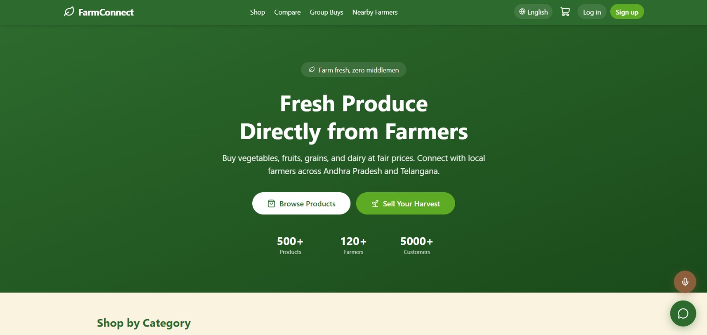
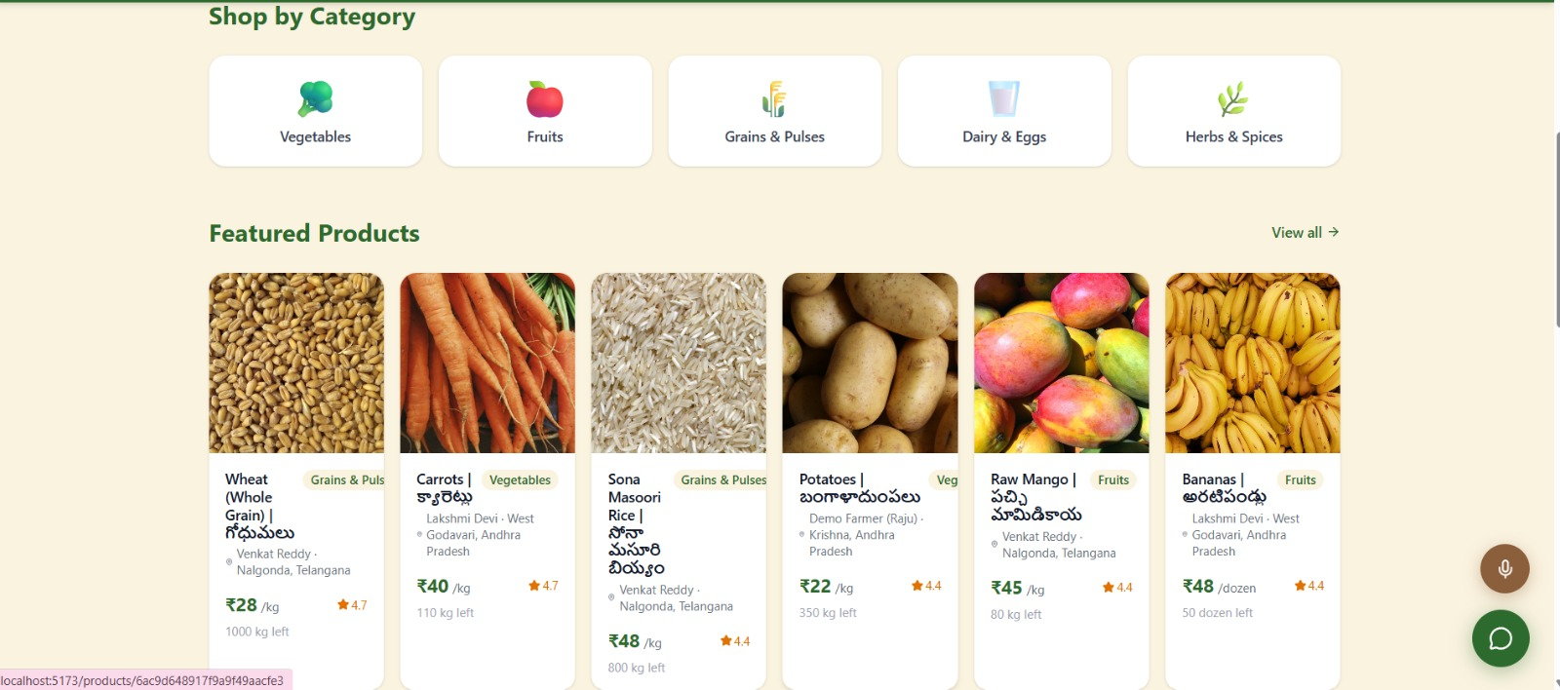
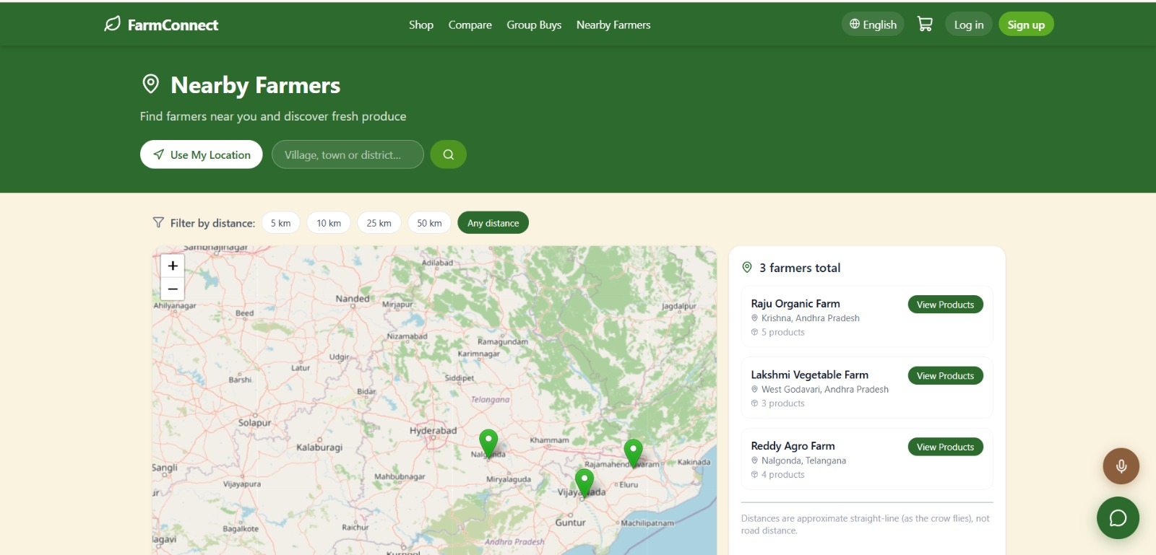
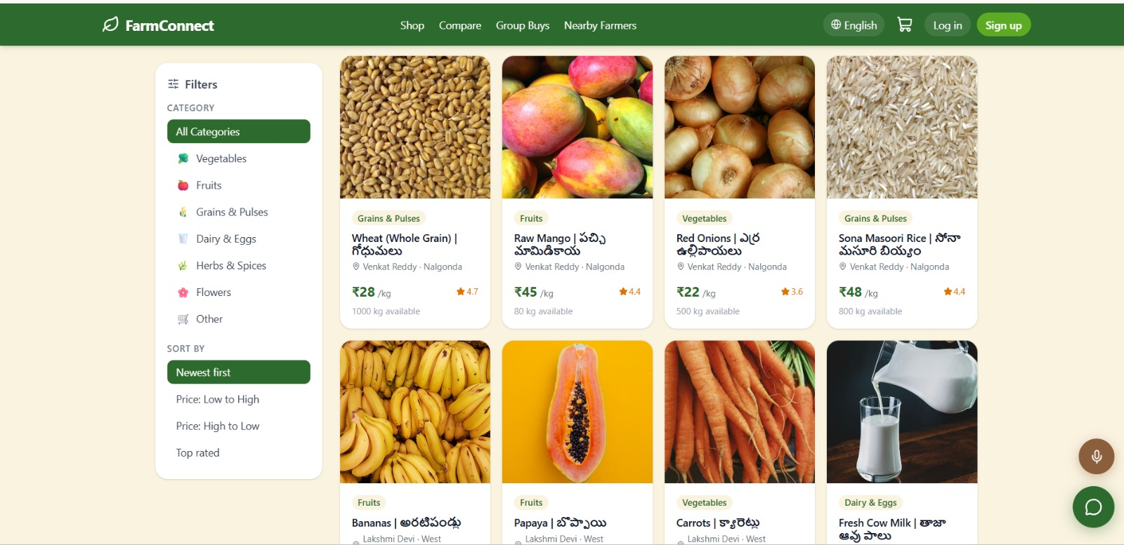

Slide 9
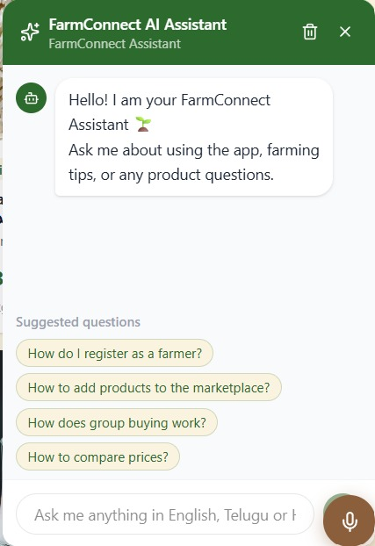
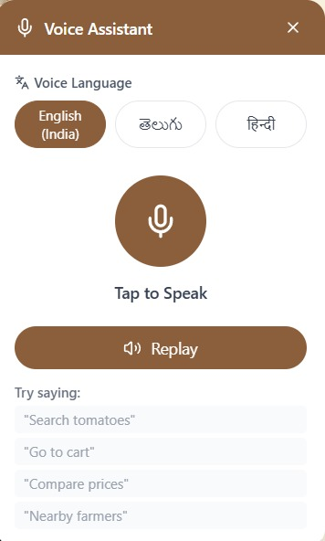

Slide 10
Thank you!

